Slide 1
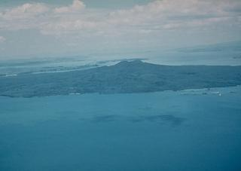
Shield volcanoes by Sadie and Ashton

Slide 2
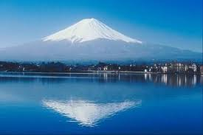
The shield volcanoes are mostly found in Hawaii. Sometimes they are so wide they cover half the island.This volcano is a cilinder shaped volcano.

Slide 3
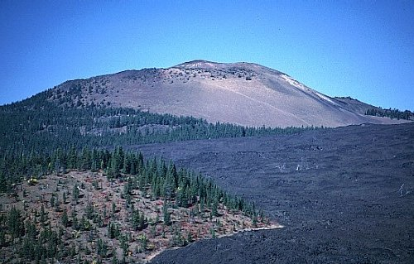
These volcanoes are formed by fluid lava flows.

Slide 4
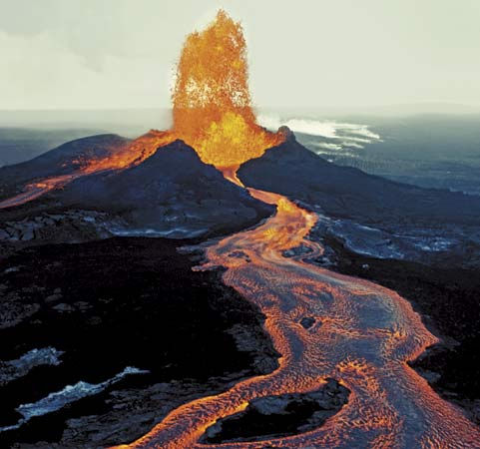
The lava comes out of the central vent and goes out the sides and top. The volcanoes lava comes out because it gets to crouded inside the volcano and theres no room under ground.

Slide 5
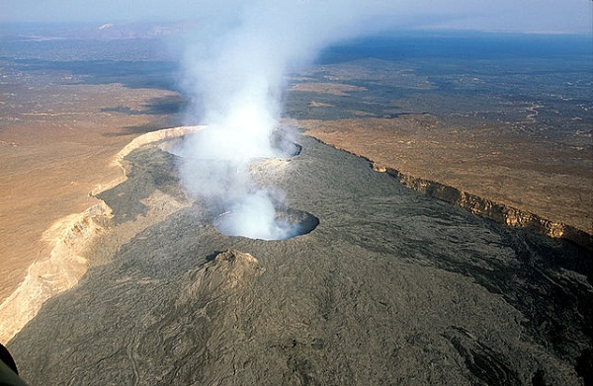
You are to stay very far from a shield volcano because there lava goes very far in a short period of time!

Slide 6
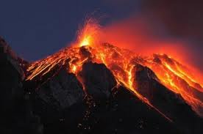
One of the most famous shield volcano is the mauna loa The mauna loa is the biggest volcano. The lastest eruption from it was in 1984.

Slide 7
Pictures found on google. Imformation found on k12.hi.us/~kapunaha/student_projects/volc_blowout/shield_volcano.htm www.volcano.si.edu/education/tpgallery.cfm?category=shield%

Slide 8
